Slide 1
Graduatıon project progress presentatıon
ADVISOR : MİTAT UYSAL
BERKAN ŞEVLİ 201335019

Slide 2
Overview
Project Purpose and Target
Time Plan (Gantt Chart)
Project Requirements
Sotwware Design
Uml Class Diagram
Uml Use Case Diagram
Database Design
ER Diagram

Slide 3
Project purpose and targets
The purpose and target of the is to enable companies to track the amount of stock, inventory entry and inventory output.
Users will be able to easily check and arrange their inventory from their smartphones

Slide 4
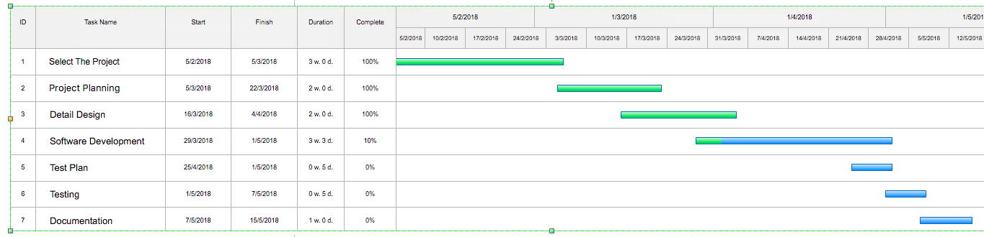
Tıme plan

Slide 5
Project requırements
Android Studio IDE
Firebase for Database
Java Code Knowledge

Slide 6
SoftWare desıgn
I am going to use Android Studio Platform for project. Because I got mobile application with Android courses in the past and I have some basic projects on Android.

Slide 7
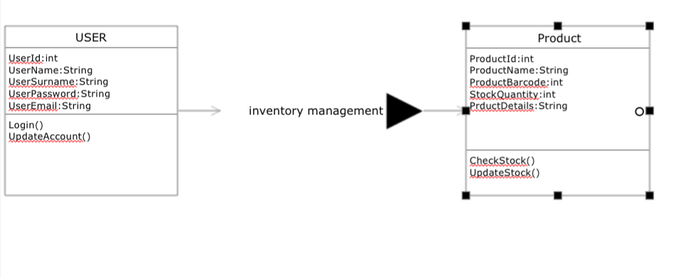
UML CLASS Dıagram

Slide 8
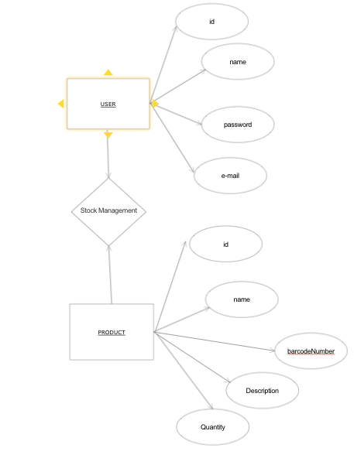
Er Dıagram

Slide 9
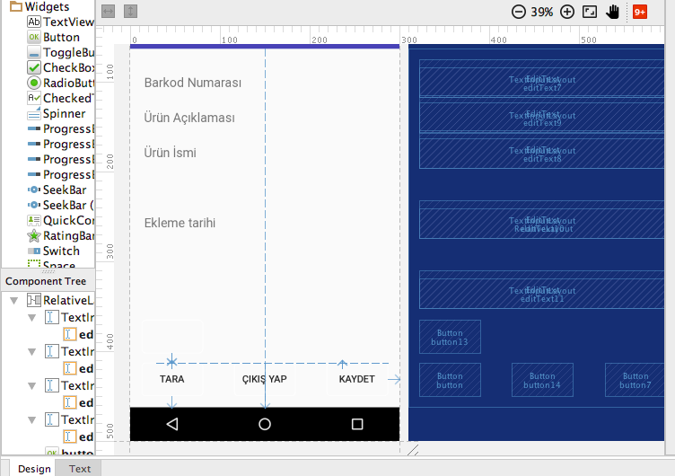

Slide 10
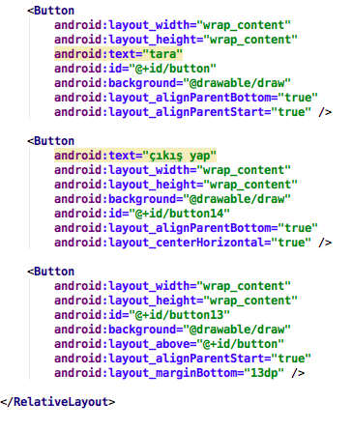

Slide 11
